Slide 1

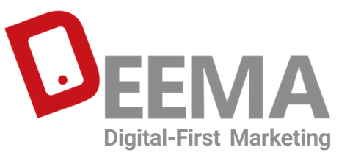
Portfolio Highlights
02182100621 | deema.agency

Slide 2



In today's advertising world, having a strong online presence is crucial. In this context, Deema, with its deep understanding of industry data, provides digital marketing strategies that deliver results for both online and offline businesses. Digital-First marketing isn't just about using digital tools; it's a mindset shift that prioritizes online interaction and experience throughout the brand's customer journey. With this approach, Deema helps companies stay ahead in connecting with their audience, building loyalty, and achieving sustainable growth in the digital age.
Our Mission

Slide 3







Our Values
Strategic
Digital-First
To achieve success, we use strategic, data-driven approaches. With this mindset, we transform our clients into industry leaders.
Data Driven
Creative
We believe that a digital-First marketing approach, utilizing data and innovative strategies, can enhance effective and targeted communication with customers.
By analyzing market trends and consumer behavior in detail, we define solutions that align with our clients' business objectives.
Results-Oriented
We consider creativity the heartbeat of our digital marketing campaigns. With innovative ideas tailored to our clients' needs, we pave the way for success.
With a focus on clear goals and results-driven strategies, combined with expertise and experience, we guarantee the success and efficiency of advertising campaigns.

Slide 4
Statistics We Take Pride In
+10
+21
Collaborating in Middle Eastern Countries
Industries We Have Experience In
+3400
+218
+10
Number of Partnered Media
Top brands trust us
Years of Experience in Digital Marketing

Slide 5























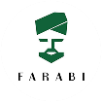




































Partnering with Leading and Renowned Brands
Over 1,000 businesses have trusted us

Slide 6

We drive results by providing tailored solutions.

Slide 7





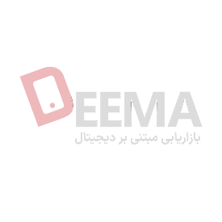
Media management
Consulting | Planning | Media Buying | Campaign Execution | Optimization
Campaign design
Creativity | Strategy Development | Advertising Content Production | Campaign Execution | Gamification
Performance marketing
Affiliate Marketing | App Installation (CPI) | Performance Marketing (CPC, CPA, CPL, …)
Services
International
Market Research | Strategy Development | Creativity Based on Culture | Campaign Management and Execution

Slide 8
Portfolio

Slide 9

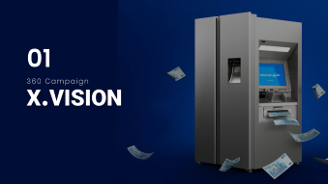
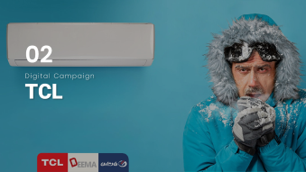

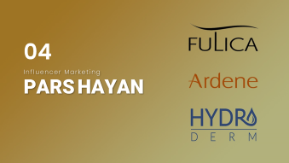
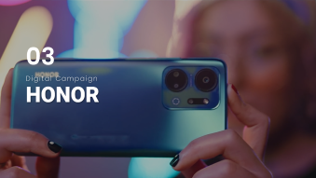
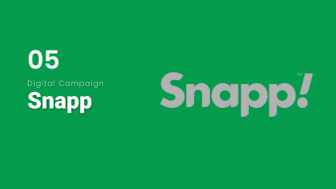
Portfolio Highlights
Designed for Samsung Electronics
02182100621 | deema.agency

Slide 10
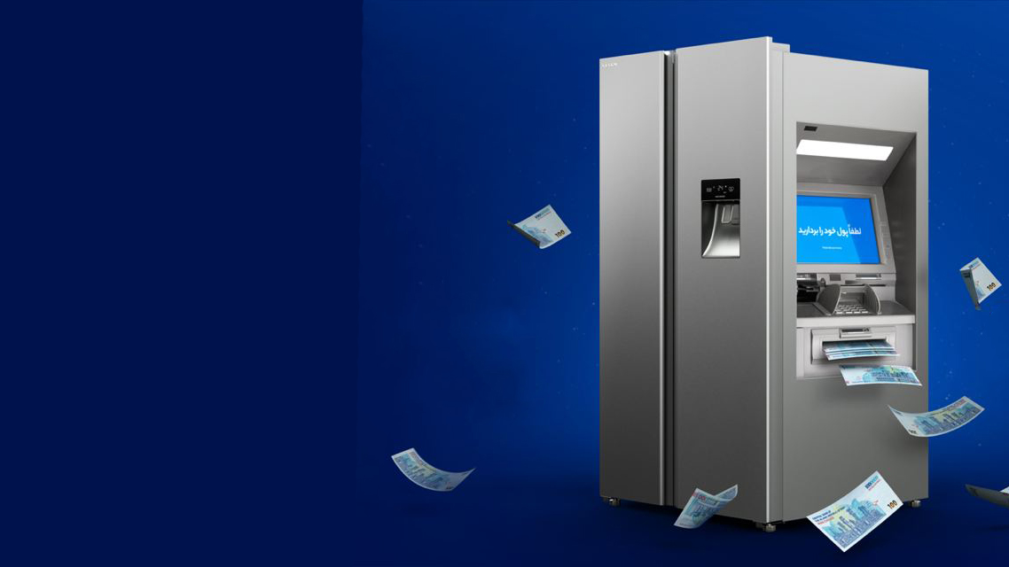
01
360 Campaign
X.VISION

Slide 11
01
SUMMARY
X.VISION
XVISION is recognized as a reputable home appliance brand in Iran. Despite its outstanding track record in television production, many consumers are still unaware of the variety and quality of its refrigerators and freezers. To address this, a targeted campaign was designed and executed, focusing on introducing and boosting sales of three models of XVISION refrigerators.

Slide 12
01
Solutions
X.VISION
To design this campaign, customer behavior when purchasing refrigerators was analyzed, revealing three key factors influencing their decision: brand image, price, and reducing dissonance. To address these, the following solutions were implemented:
3 million Toman cashback
Extended after-sales service from 2 to 3 years
Free installation and setup
These measures increased customer trust, made the price more attractive, and strengthened the brand image. The campaign was also timed with the Asian Cup, featuring a teaser ad with Javad Khiabani voice.

Slide 13

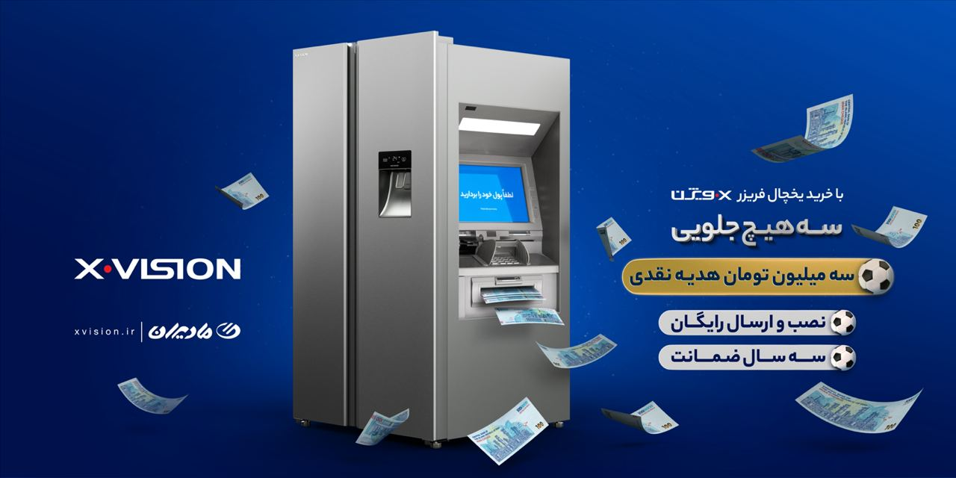
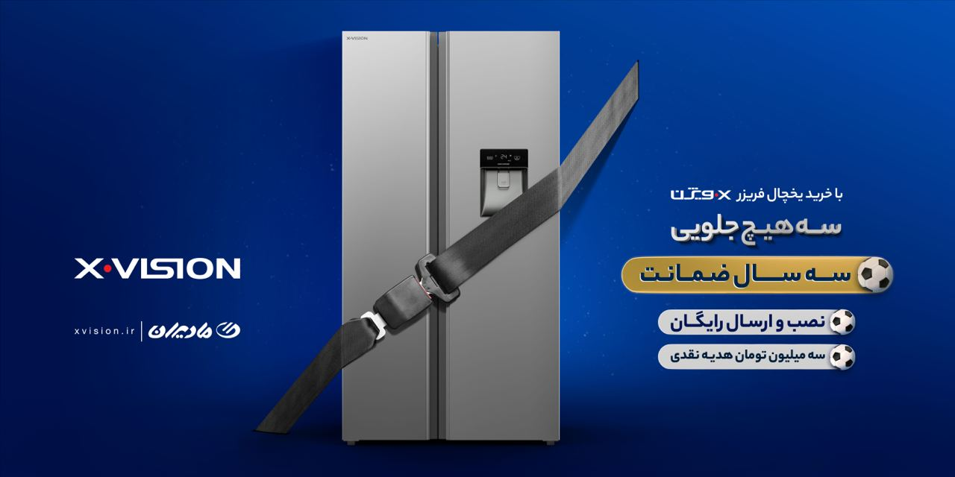


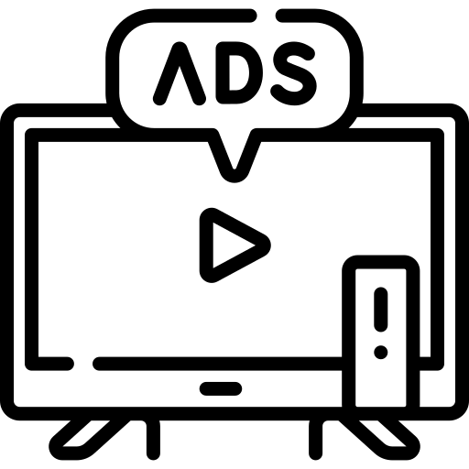


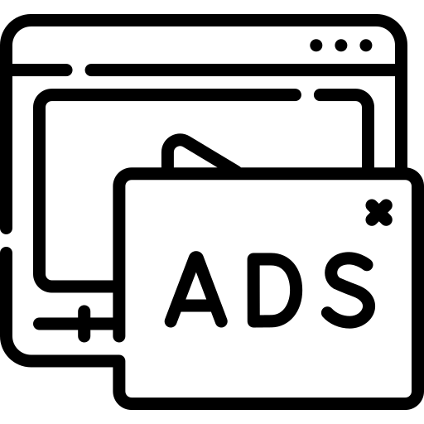


01
Contents & Channels
X.VISION
Content played a crucial role in the success of this campaign, so it was essential that the scenario and the produced content were of the highest quality. In addition to the teaser, CGI advertisements were also included in the plan, which had a significant impact on attracting attention and engaging customers, especially on social media platforms. This campaign was implemented seamlessly across all selected marketing channels and executed within the designated timeframe.
Billboards
Native Ads
Banner
TV Ads
OOH
Influencers
Pre-roll
Gamification
Advertorial

Slide 14
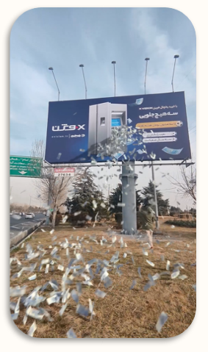
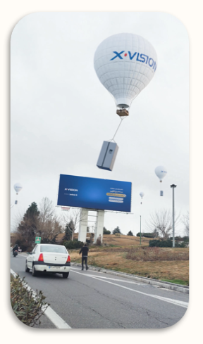
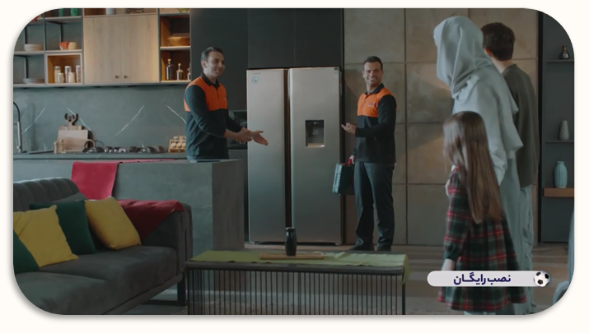


01
Contents & Channels
X.VISION
Video Content
CGI Ads
Native Ads
Banner
TV Ads
OOH
Influencers
Pre-roll
Gamification
Advertorial
BACK TO Category

Slide 15

02
Digital Campaign
TCL

Slide 16
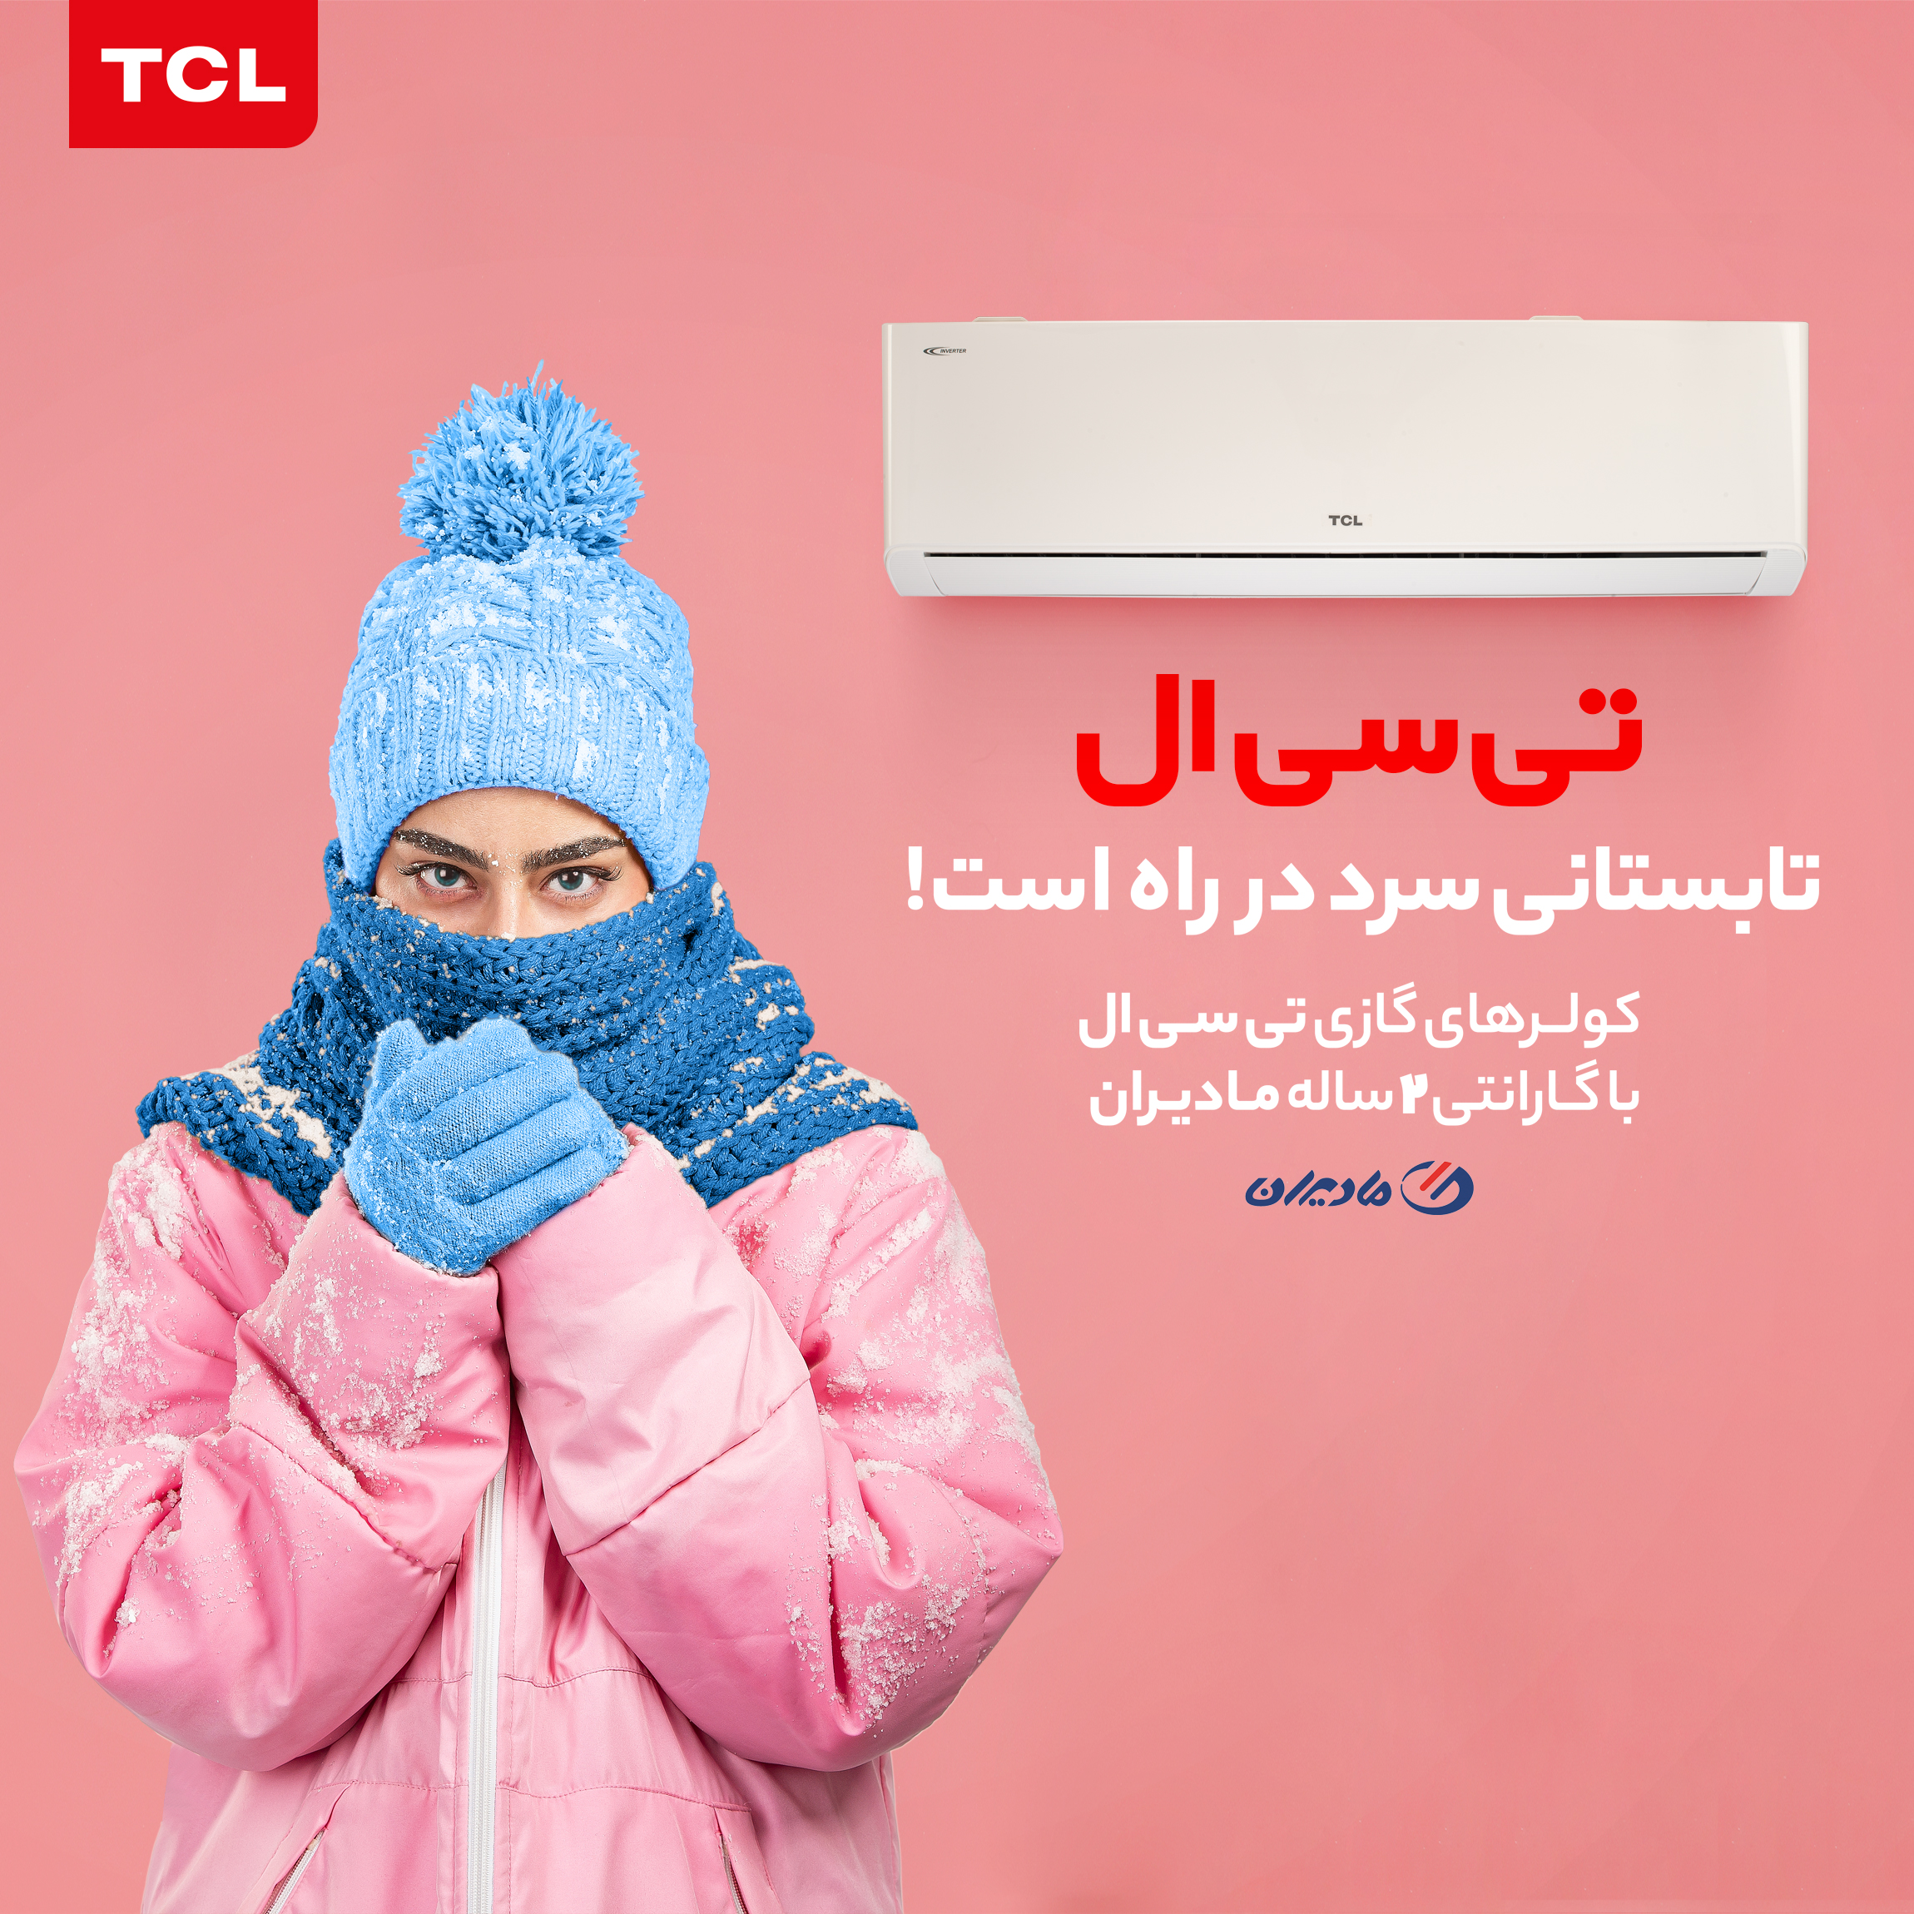
02
SUMMARY
TCL
TCL, as one of the popular and well-known brands in Iran, decided to launch a campaign to raise awareness about its air conditioners with the arrival of summer and the rising temperatures. Due to the current conditions and the inability to run outdoor advertisements, it was decided to execute the campaign in the digital space by adopting an appropriate strategy.
It is important to note that the creative aspect of this campaign was not designed by Deema; Deema was responsible solely for the strategy and implementation of the digital advertising.

Slide 17

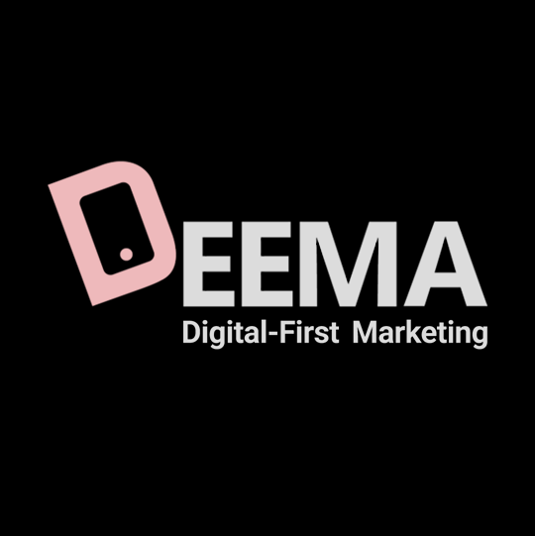
02
Contents & Channels
TCL
Considering the objective, it was essential to choose the most effective channels for this campaign. Therefore, Deema's strategy team adopted a creative approach. By accurately identifying the target audience personas, the best digital marketing channels and product-related pages were selected. Using Deema's data-driven dashboard, the campaign achieved the highest brand awareness at the best cost.
Native Ads
Banner
TV Ads
OOH
Influencers
Pre-roll

Slide 18
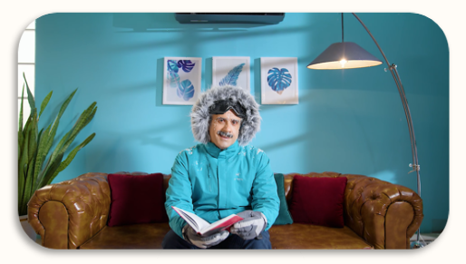
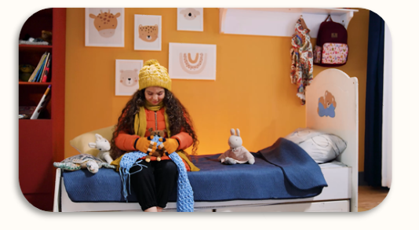
02
Contents & Channels
TCL
The use of digital marketing trends, such as video advertising, combined with continuous optimization, was one of the key reasons for the success of this campaign. Over a span of 30 days, the campaign garnered more than 190 million views, with a user engagement rate of over 10%, which is an excellent result for a brand awareness campaign.
Video Content
Native Ads
Banner
TV Ads
OOH
Influencers
Pre-roll
BACK TO Category

Slide 19
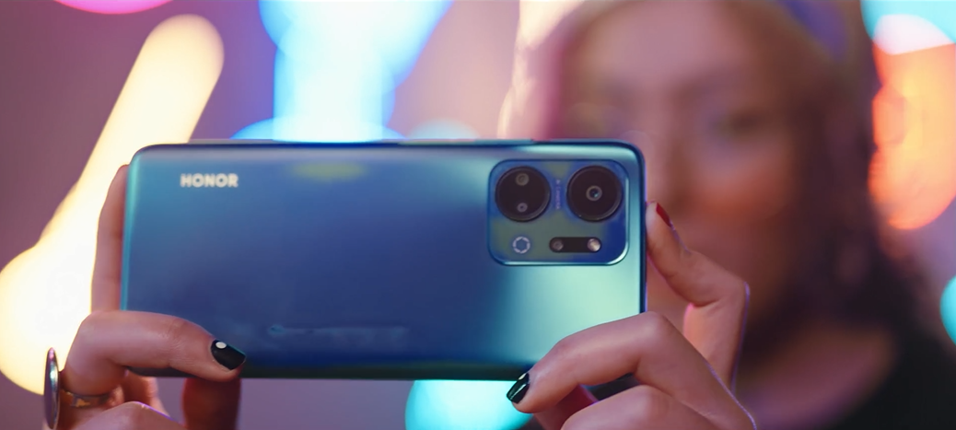
03
Digital Campaign
HONOR

Slide 20
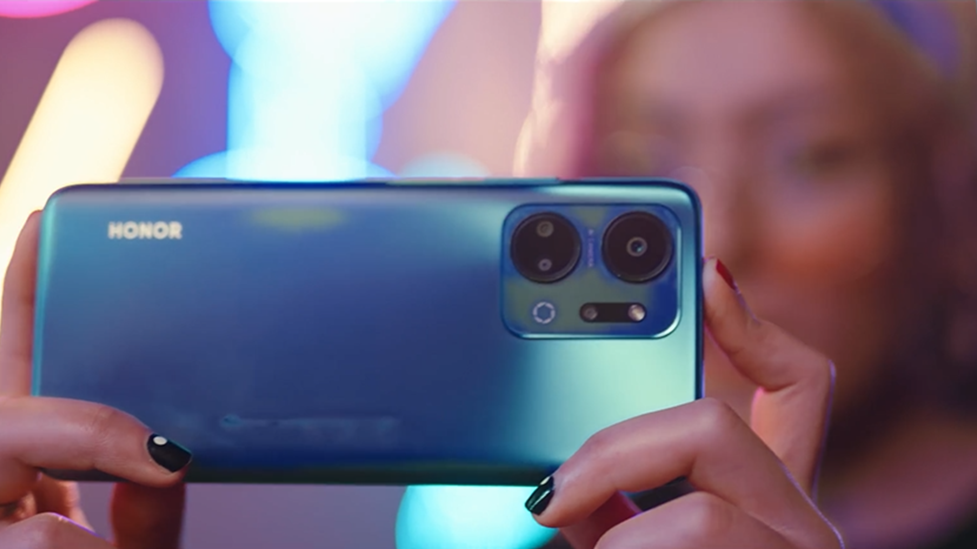
03
SUMMARY
HONOR
HONOR phones are known in the Iranian market but aren't a top priority for initial mobile purchases. Therefore, Media Pardazesh, the importer of HONOR phones, identified the need to raise awareness of the brand's presence in Iran for the new HONOR Xa series.
Based on market research and audience behavior, we found that consumers in this segment, regardless of budget, expect a lot from the phone’s features.

Slide 21
03
Solutions
HONOR
The main question when designing this campaign was how to highlight the phone's affordability without diminishing the brand's value and still convey its value propositions.
The solution we reached was to position the phone's affordability as a secondary message in the campaign and emphasize in the primary message that the phone is suitable for everyone. This implicitly conveys its affordability without directly stating it. We then targeted specific groups based on the phone's features, such as gamers, bloggers, and people using the phone for online businesses, focusing on its high-quality camera and strong processor.

Slide 22
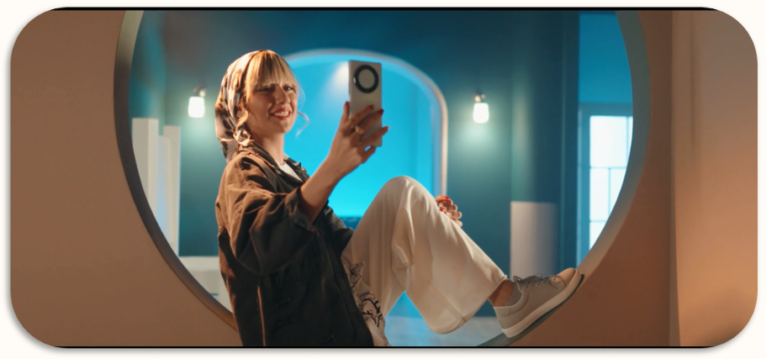

03
Contents & Channels
HONOR
For implementing this campaign, after setting goals and evaluation metrics, identifying the target audience, and creating the necessary content, the best channels for distribution and targeting the personas were evaluated and selected
Native Ads
Banner
Influencers
Pre-roll
Advertorial
POSM
BACK TO Category

Slide 23

04
Influencer Marketing
PARS HAYAN

Slide 24
04
SUMMARY
PARS HAYAN
Pars Hayan, one of the largest holding companies in Iran specializing in beauty and personal care products, launched a campaign to raise awareness and inform the public about its latest products for its most popular brands.
Given the target audience for these products, social media was chosen as the primary marketing channel, and extensive advertising campaigns were executed across these platforms.

Slide 25
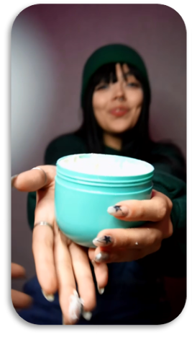
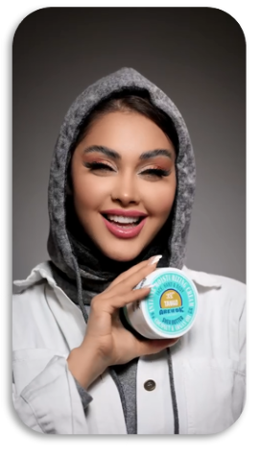
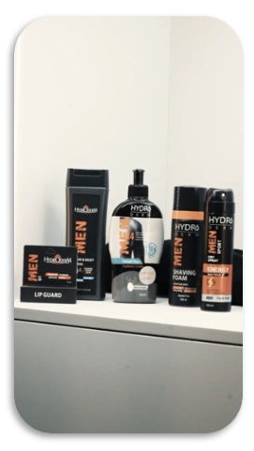
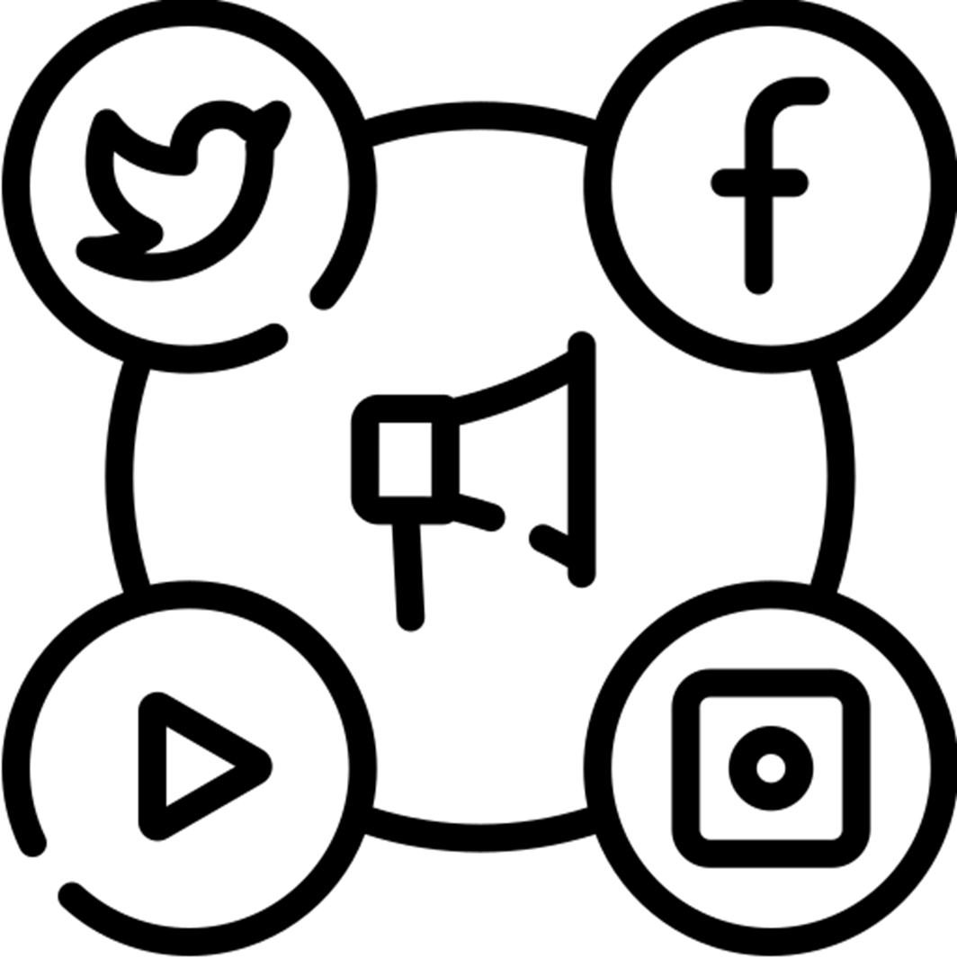
04
Contents & Channels
PARS HAYAN
This campaign was executed extensively and with precise planning, in collaboration with influencer marketing networks and the most popular social media pages, by Deema at various stages. The campaign was highly expansive, and within just three month, over 300 influencers worked with brands such as FULICA, Ardene, and HYDRO DERM.
Social Media
Influencers

Slide 26
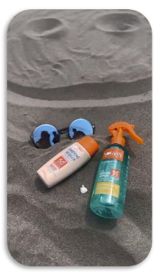
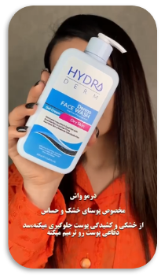
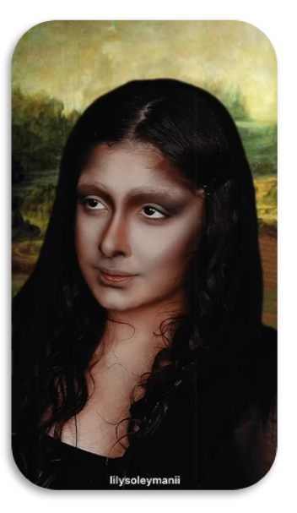
04
Contents & Channels
PARS HAYAN
One of the biggest challenges of large-scale advertising on social media is the precise selection of influencers, effective campaign management, and monitoring the execution. This was successfully implemented through collaboration between Deema's strategy, media team, and project management. Throughout the campaign, real-time reports were closely monitored and optimized.
Social Media
Influencers
BACK TO Category

Slide 27

05
Digital Campaign
Snapp

Slide 28
05
Problem
Snapp
Snapp, the largest startup in Iran, began as a ride-hailing service in 2014 and has since transformed into a versatile, multi-functional app. Today, it offers a wide range of services, including transportation, food delivery, bill payments, and even healthcare. Over the years, Deema has partnered with various Snap vendors to execute some of the biggest and most successful digital marketing campaigns.

Slide 29
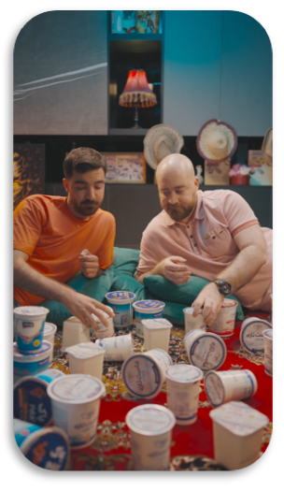
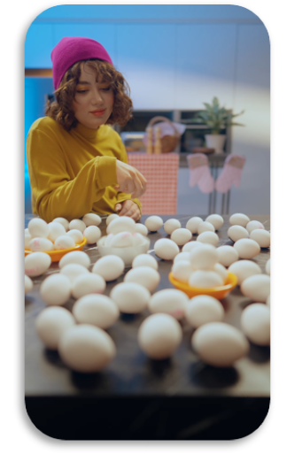
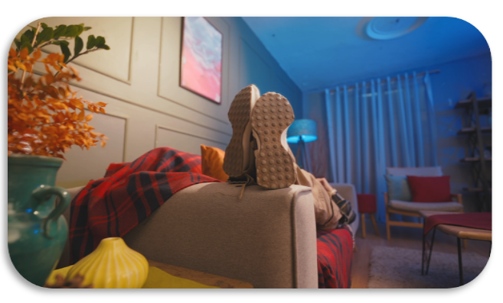







05
Contents & Channels
Snapp
Snapp Express
The content provided is just a part of the collaboration with Snapp in the field of video advertising, which has been published across various channels, including pre-roll ads.
Snapp Food
Native Ads
Banner
Influencers
Pre-roll
Advertorial
Social Media
Gamification
Video Banner
Install Ads
BACK TO Category

Slide 30

06
Video Marketing
digikala

Slide 31

06
Problem
digikala
Digikala, the largest online store in Iran, has collaborated with Deema over various periods for its subsidiary startups. Digikala and its affiliated companies are known for their innovation, and the main goal of these campaigns was to build brand awareness and familiarize the audience. Deema Digital-First Marketing Agency worked alongside Pindo and Digikala Magnet on these campaigns.

Slide 32
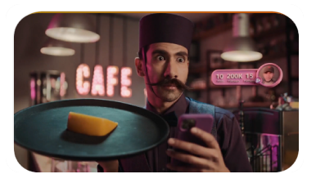
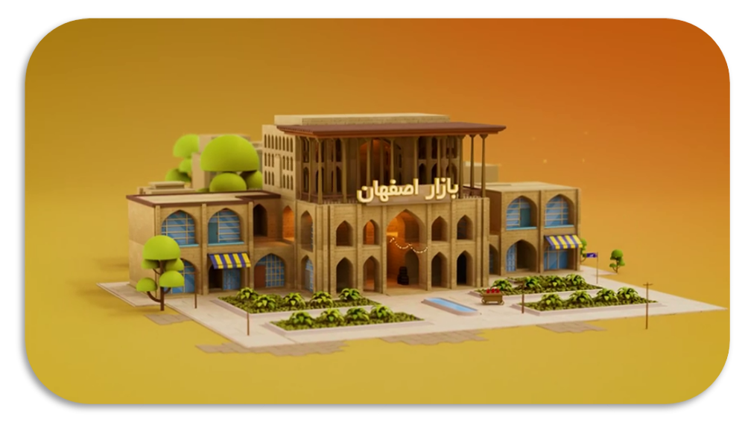
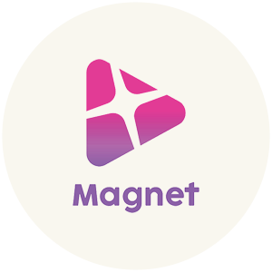

06
Contents & Channels
digikala
In this campaign, Digikala aimed to establish Pindo as a safe and direct online marketplace in the minds of its audience. Deema's strategy and creativity team, through market research and understanding audience behavior, designed content with a slogan and elements aligned with Iranian culture.
An online market as vast as Iran.
Native Ads
Banner
Influencers
Pre-roll
Advertorial
Social Media
Video Banner
BACK TO Category

Slide 33
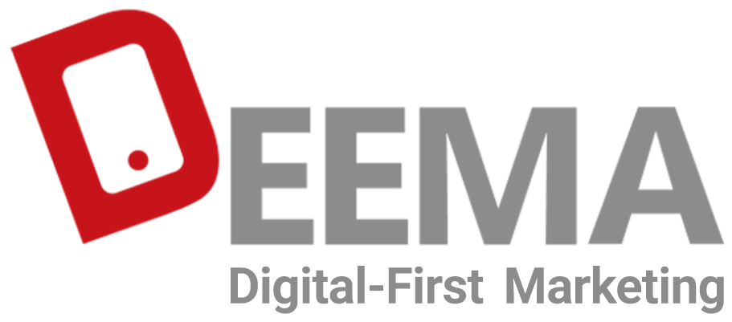
Contact Us
021 – 821 00 621
www.deema.ir
No. 10, 15th St., Hassan Seif St., Shahrake Gharb, Tehran, Iran

